Slide 1
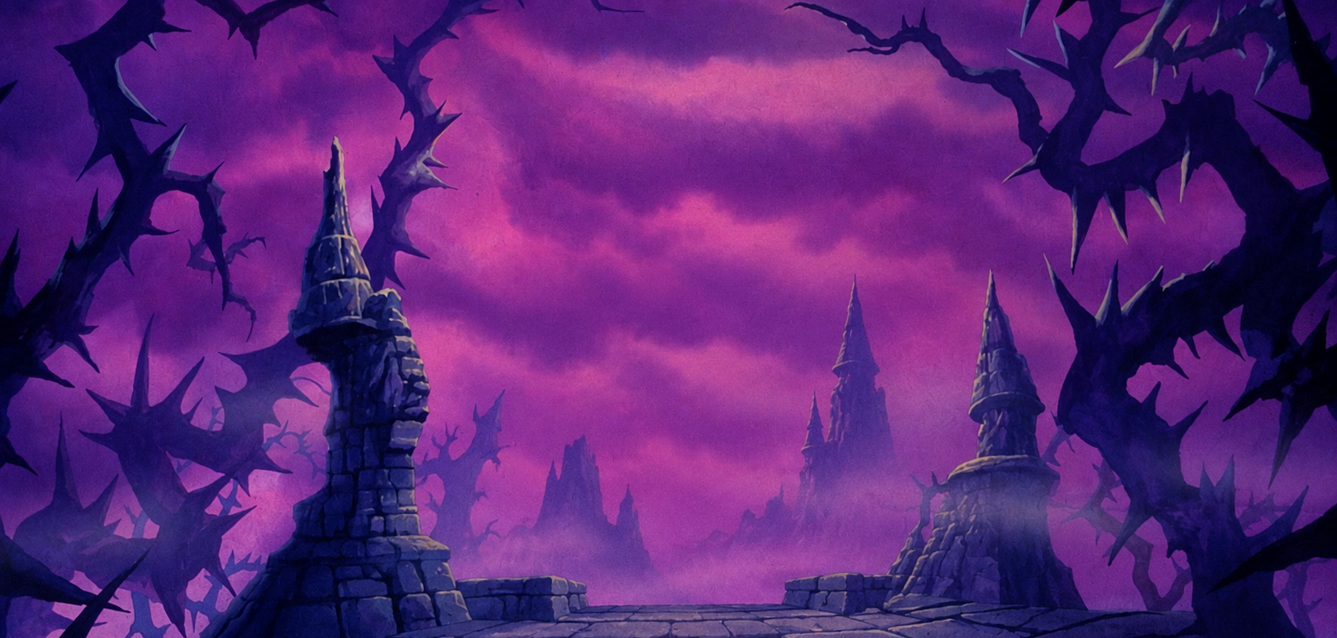
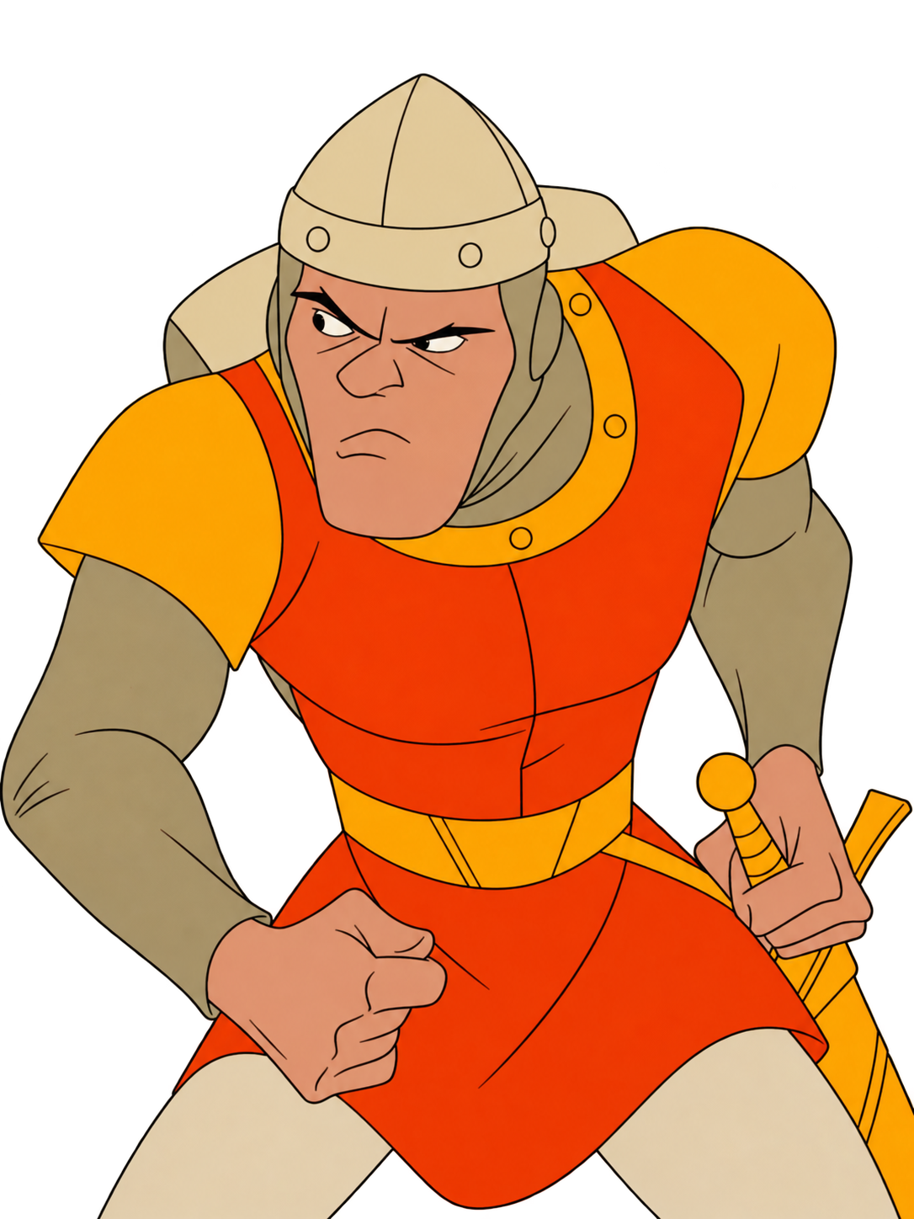
LAiRP 2026
The death scenes
Group: Turing / Lovelace / Hopper / Shannon
Our question: …

Slide 2
Exercise F
Feel free to add slides
What the template provides is the bare minimum. Here is the evaluation grid:
 | Pass | Fail
Plausible failures | Every failure could realistically happen in research practice, is specific, and is placed at a research stage (a column of the canvas). | Exaggerated scenarios (“the AI writes the whole thesis”), or failures with no stage.
Correct diagnosis | For each failure: what goes wrong, why it is a problem, and which principle, guideline or good practice it breaks (e.g. data at the wrong level, a tool not allowed for that data, no human check, an unverified source). | Failures listed without saying what they break.
Consequences | Each failure has a realistic consequence: privacy or confidentiality breach, poor quality, no reproducibility, unsupported claims, ethical or legal problems, loss of trust in the findings. | Consequences missing, vague, or out of proportion.
The rescue targets the worst failures | Two or three changes that address the most important risks, and that are realistic to implement. | Changes that miss the main risks, or that could not be done in practice.
Appropriate safeguards | The rescue uses approved tools, keeps data at its level, adds human checks where the disaster had none, verifies sources and outputs, and documents decisions and AI use (what to document is defined in Class 4). | Data still at the wrong level, no human check, or unverified outputs.
Trade-offs | Each change names what it costs: time, convenience, automation, infrastructure, human effort. | Costs not mentioned.
Group: …

Slide 3
Exercise F
Our project
From Monday: your question, and why AI is in it. On Wednesday this is your first minute.
Our research question the one you took to the project on Monday
AI is the object / the instrument / both say which, and because…
The data, and its level what goes in: public / internal / confidential / secret
The threat that could sink it from your Monday chain, or a better one now
Group: …

Slide 4
Exercise F
The death scenes: a workflow that fails on purpose
Every failure plausible (something researchers really do), and labelled: which row it breaks, and what it costs.
 | Study design | Literature | Data collection | Analysis | Writing | Dissemination
Step what happens |  |  |  |  | → Class 4
Use compress / extract / expand / formalise / none
Tool a concrete one
Data level of what goes in
Allowed? yes / no / with condition
Human gate who checks, where (or nobody)
Log needed? yes / no (contents: Class 4)
What this breaks, and what it costs
Group: …

Slide 5
Exercise F
How we'd play it to the end
The two or three worst failures from the previous slide, and what you would change. This is your real workflow.
1
2
3
optional
The failure which one, and the row it broke
The change tool, data level, human gate: what you do instead
What the change costs time, model quality, feasibility
The failure which one, and the row it broke
The change tool, data level, human gate: what you do instead
What the change costs time, model quality, feasibility
The failure which one, and the row it broke
The change tool, data level, human gate: what you do instead
What the change costs time, model quality, feasibility
Check the rescue against the rows of the previous slide: a human gate wherever the disaster had none, data at its level, tools chosen for a reason.
Group: …

Slide 6
Let’s keep talking

