Slide 1
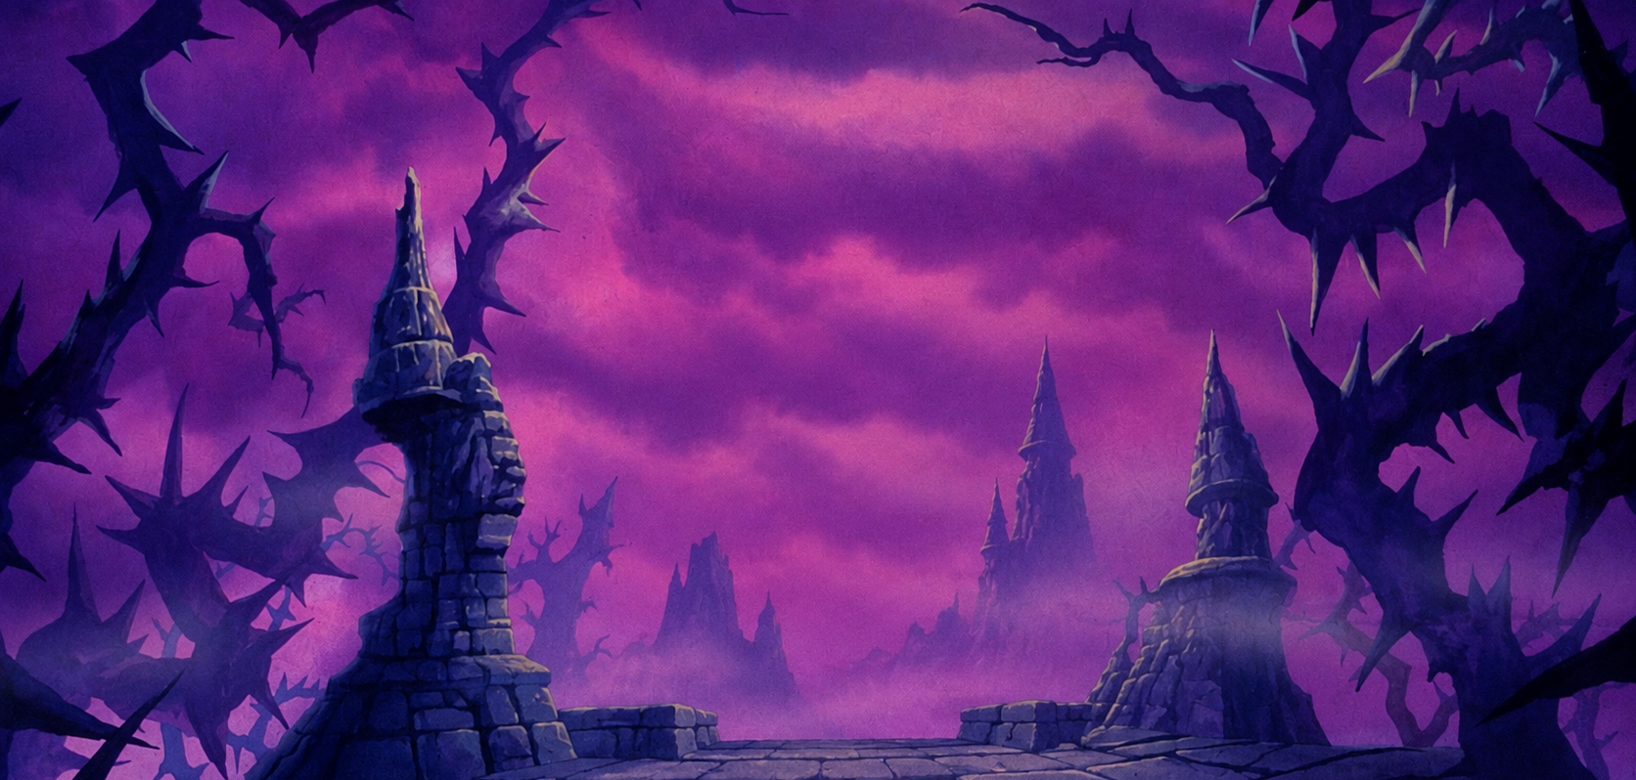

LAiRP 2026
The death scenes
Group: Turing / Lovelace / Hopper / Shannon
Our question: …
Notes:
Exercise F canvas. Replace the group name and write your question from Monday. Slide 2 presents your project, slide 3 is the disaster, slide 4 the rescue. On Wednesday you present them in that order.

Slide 2
Exercise F
Our project
From Monday: your question, and why AI is in it. On Wednesday this is your first minute.
Our research question the one you took to the project on Monday
AI is the object / the instrument / both say which, and because…
The data, and its level what goes in: public / internal / confidential / secret
The threat that could sink it from your Monday chain, or a better one now
Group: …
Notes:
Fill this first, in two minutes: copy the question, the because and the threat from your group's Monday chain (RoomPulse), and add the data you would work with and its level. On Wednesday this slide is your first minute; the disaster and the rescue come next.

Slide 3
Exercise F
The death scenes: a workflow that fails on purpose
Every failure plausible (something researchers really do), and labelled: which row it breaks, and what it costs.
 | Study design | Literature | Data collection | Analysis | Writing | Dissemination
Step what happens |  |  |  |  | → Class 4
Use compress / extract / expand / formalise / none
Tool a concrete one
Data level of what goes in
Allowed? yes / no / with condition
Human gate who checks, where (or nobody)
Log needed? yes / no (contents: Class 4)
What this breaks, and what it costs
Group: …
Notes:
Fill the white cells for the phases where your disaster happens; leave the others empty. The grey Writing column is left for Michele's session this afternoon. Every failure needs its label in the last row: a failure without a label is a gag, not a finding. Reject 'the AI writes the thesis and we send it to Nature': it breaks no specific row, and nobody would do it.

Slide 4
Exercise F
How we'd play it to the end
The two or three worst failures from the previous slide, and what you would change. This is your real workflow.
1
2
3
optional
The failure which one, and the row it broke
The change tool, data level, human gate: what you do instead
What the change costs time, model quality, feasibility
The failure which one, and the row it broke
The change tool, data level, human gate: what you do instead
What the change costs time, model quality, feasibility
The failure which one, and the row it broke
The change tool, data level, human gate: what you do instead
What the change costs time, model quality, feasibility
Check the rescue against the rows of the previous slide: a human gate wherever the disaster had none, data at its level, tools chosen for a reason.
Group: …
Notes:
At 12:10 the facilitator says once: 'five minutes: go to the rescue slide.' A group with no rescue on Tuesday has a comedy routine on Wednesday, not a workflow.

Slide 5
Let’s keep talking

